Slide 1

PVKK INSTITUTE OF TECHNOLOGY
(Approved by AICTE & Affliated by JNTUA,Anantapuramu)
A
Study on
“STOCK PRICE PREDICTION USING TWITTER DATASET”
By
MARAPAREDDY PRAMOD KUMAR REDDY
Reg. No : 233N1F00C0
Under the esteemed guidance of
Mrs. A. SUSANNA RANI, MCA
Assistant Professor
Department of Computer Applications
DEPT.OF.COMPUTER APPLICATIONS 01

Slide 2
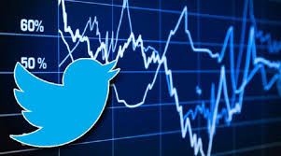

STOCK PRICE PREDICTION USING TWITTER DATASET
DEPT.OF COMPUTER APPLICATIONS 02

Slide 3
CONTENTS
ABSTRACT
INTRODUTION
LITERATURE SURVEY
HARDWARE AND SOFTWARE REQUIREMENTS
SYSTEM DESIGN
SOFTWARE ENVIRONMENT
EXISTING SYSTEMS
PROPOSED SYSTEMS
DATA FLOW DIAGRAMS
CONCLUSION
DEPT.OF.COMPUTER APPLICATIONS 03

Slide 4
ABSTRACT
In this project, we apply sentiment analysis and machine learning principles to find the correlation between ”public sentiment” and ”market sentiment”.
We use twitter data to predict public mood and use the predicted mood and previous days’ DJIA values to predict the stock market movements.
We investigate the impact of sentiment expressed through Twitter tweets on stock price prediction.
DEPT.OF.COMPUTER APPLICATIONS 04

Slide 5
INTRODUCTION
In this project, we test a hypothesis based on the premise of behavioural economics, that the emotions and moods of individuals affect their decision making process, thus, leading to a direct correlation between ”public sentiment” and ”market sentiment”.
We perform sentiment analysis on publicly available Twitter data to find the public mood and the degree of membership into 4 classes – Calm, Happy, Alert and Kind (somewhat like fuzzy membership).
We use these moods and previous days’ Dow Jones Industrial Average (DJIA) values to predict future stock movements.
DEPT.OF.COMPUTER APPLICATIONS 05

Slide 6
LITERATURE SURVEY
Behavioural economics tells us that emotions can profoundly affect individual behaviour and decision-making.
We analyse the text content of daily Twitter feeds by two mood tracking tools.
First one is Opinion Finder that measures positive vs. negative mood.
Another one is Google-Profile of Mood States (GPOMS) that measures mood in terms of 6 dimensions (Calm, Alert, Sure, Vital, Kind, and Happy)..
DEPT.OF .COMPUTER APPLICATIONS 06

Slide 7
HARDWARE REQUIREMENTS
System : i3 or above
Ram : 4 GB
Hard Disk : 40 GB
DEPT.OF.COMPUTER APPLICATIONS 07

Slide 8
SOFTWARE REQUIREMENTS
Operating System : Windows 8 (or) Above
Coding Language : Python
DEPT.OF.COMPUTER APPLICATIONS 08

Slide 9
ADVANTAGES AND DISADVANTAGES OF PYTHON
Extensible
Improved productivity
Readable
Object oriented
Free and open source
Less coding
Affordable
DEPT.OF.COMPUTER APPLICATIONS 09

Slide 10
SYSTEM DESIGN
Software development is the phase which is very important for the supernova of the software, which is called as design phase.
The design phase should satisfy the functional and non-functional requirements for the effectiveness for satisfying all the constraints and objectives of the project.
DEPT.OF.COMPUTER APPLICATIONS 10

Slide 11
SOFTWARE ENVIRONMENT
The biggest strength of python is huge collection of standard library which can be used for the following:-
Machine learning
GUI applications (like Kivy , Tkinter , PyQtetc )
Web frameworks like Django
Image processing (like Opencv , Pillow)
Web scrapping (like Scrapy, Selinium )
Test frameworks
Multimedia
Machine Learning involves building mathematical models to help understand data.
DEPT.OF.COMPUTER APPLICATIONS 11

Slide 12
EXISTING SYSTEMS
The technique used in this project builds directly on the one used by Bollen et al. [1]. The raw DJIA values are first fed into the preprocessor to obtain the processed values.
At the same time, the tweets are fed to the sentiment analysis algorithm which outputs mood values.
These mood values are used by the portfolio management system which runs the model to predict the future value and uses the predicted values to make appropriate buy/sell decisions.
DEPT.OF.COMPUTER APPLICATIONS 12

Slide 13
DISADVANTAGES OF EXISTING SYSTEMS
Existing systems often face disadvantages like :
compatibility issues with newer technologies and security vulnerabilities.
limitations in functionality and customization.
hindering innovation and digital transformation.
DEOT.OF COMPUTER APPLICATIONS 13

Slide 14
PROPOSED SYSTEMS
The proposed system thus analyzed and designed a Stock price prediction algorithms that improved over the current ones.
Firstly, we proposed a new two-stage Monte Carlo algorithm to generate N interval time series from an original one.
Secondly, for each interval time series in the generated ones, two Long Short-Term Memory Network models are trained to predict the middle point and the range..
DEPT.OF.COMPUTER APPLICATIONS 14

Slide 15
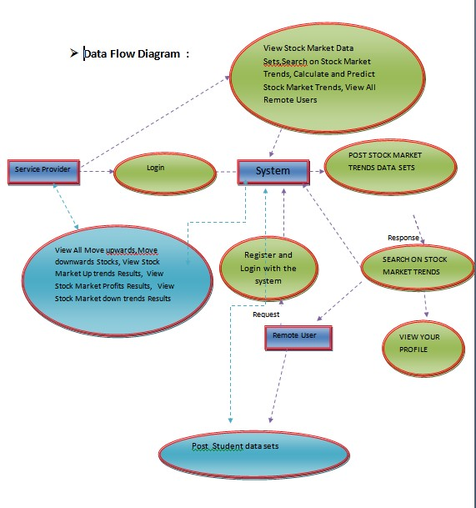
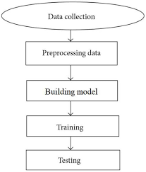
DATA FLOW DIAGRAM
DEPT.OF.COMPUTER APPLICATIONS 15

Slide 16
ADVANTAGES OF PROPOSED SYSTEMS
Data Collection:Raw data from different resources along with datasets.
Data Preprocessing: Checking, cleaning, and organizing collected data for analysis. This step involves handling missing values, removing noises, and converting data to usable format.
Building Model: After the above steps model is built. In it, different algorithms are used to check for accuracies, and depending upon those accuracies the higher accuracy algorithm is selected for the final model.
DEPT.OF.COMPUTER APPLICATIONS 16

Slide 17
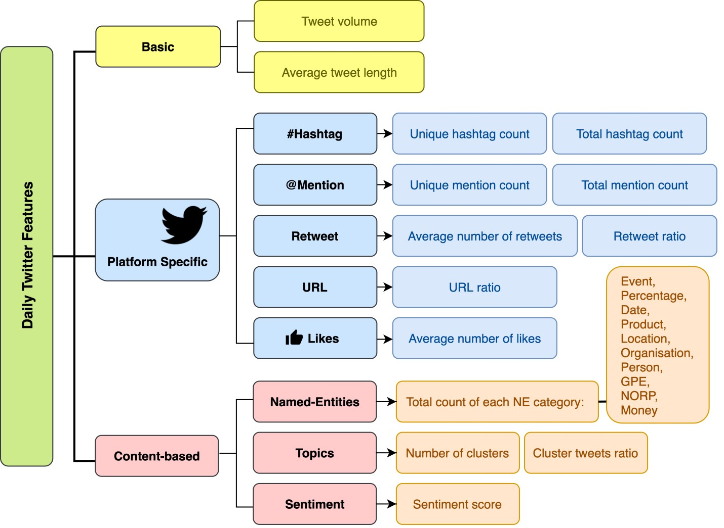
SYSTEM ARCHITECTURE
DEPT.OF.COMPUTER APPLICATIONS 17

Slide 18
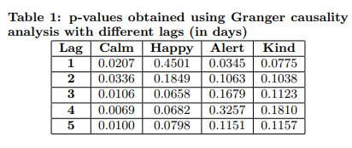
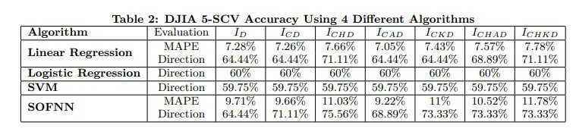
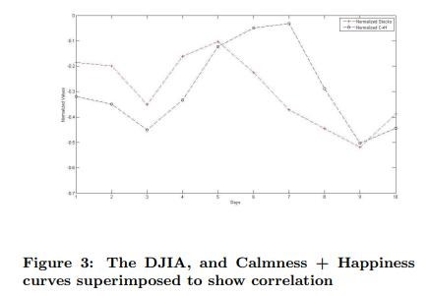
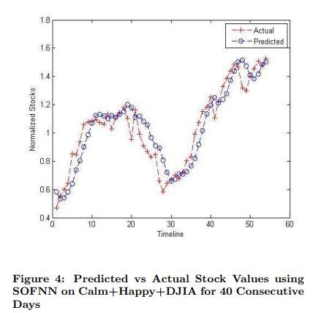
PREDICTED ALGORITHMS
DEPT.OF.COMPUTER APPLICATIONS 18

Slide 19
USE CASE DIAGRAM
upload twitter stock dataset
preprocess tweets using SPACY
split stock data into train & test
data
User
stock price prediction using SVM
stock price prediction using rando
m forest
RMSE comparision graph
DEPT.OF.COMPUTER APPLICATIONS 19

Slide 20
TESTING STRATEGY
Test strategy and approach :
Field testing will be performed manually and functional tests will be written in detail.
Test objectives :
All field entries must work properly.
Pages must be activated from the identified link.
The entry screen, messages and responses must not be delayed.
Features to be tested :
Verify that the entries are of the correct format
No duplicate entries should be allowed
Test Results: All the test cases mentioned above passed successfully. No defects encountered.
DEPT.OF.COMPUTER APPLICATIONS 19

Slide 21
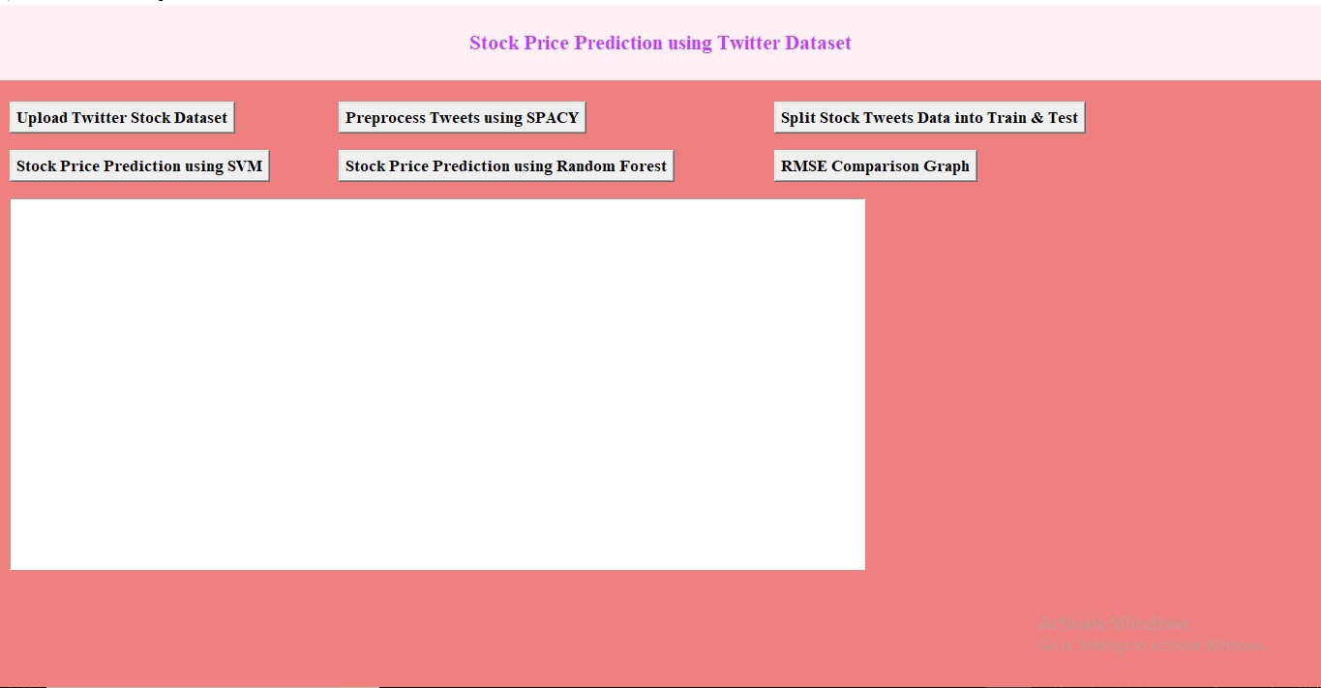
SCREENSHOTS
To run project double click on ‘run.bat’ file to get below screen
In above screen click on ‘Upload Twitter Stock Dataset’ button to upload dataset and get below screen
DEPT.OF.COMPUTER APPLICATIONS

Slide 22
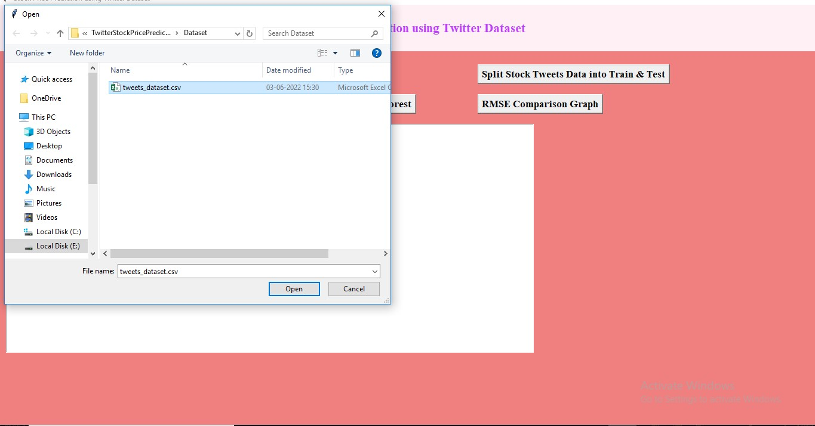
In above screen selecting and uploading tweets stock price dataset and then click on ‘Open’ button to load dataset and get below output
DEPT.OF.COMPUTER APPLICATIONS

Slide 23
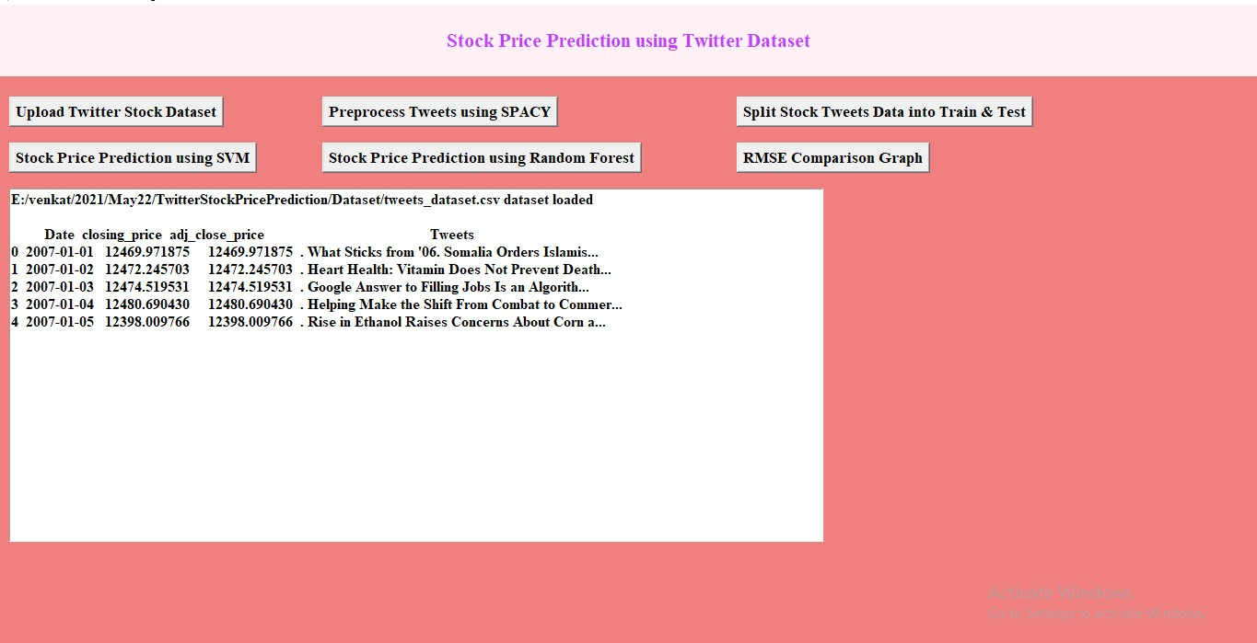
In above screen tweets and stock prices loaded and now click on ‘Preprocess Tweets using SPACY’ button to read all tweets and then find sentiment probability of each tweet in terms of positive, negative and neutral and then will get below output
DEPT.OF.COMPUTER APPLICATIONS

Slide 24
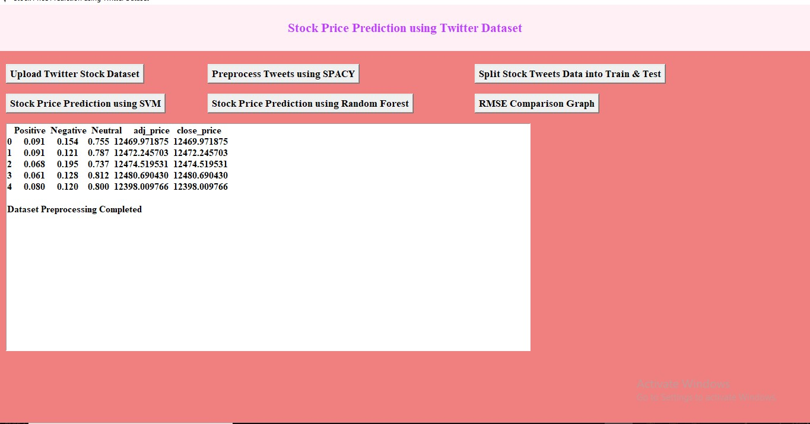
In above screen for tweet we got customer experience in terms of sentiments of stock performance and now click on ‘Split Stock Tweets Data into Train & Test’
DEPT.OF.COMPUTER APPLICATIONS

Slide 25
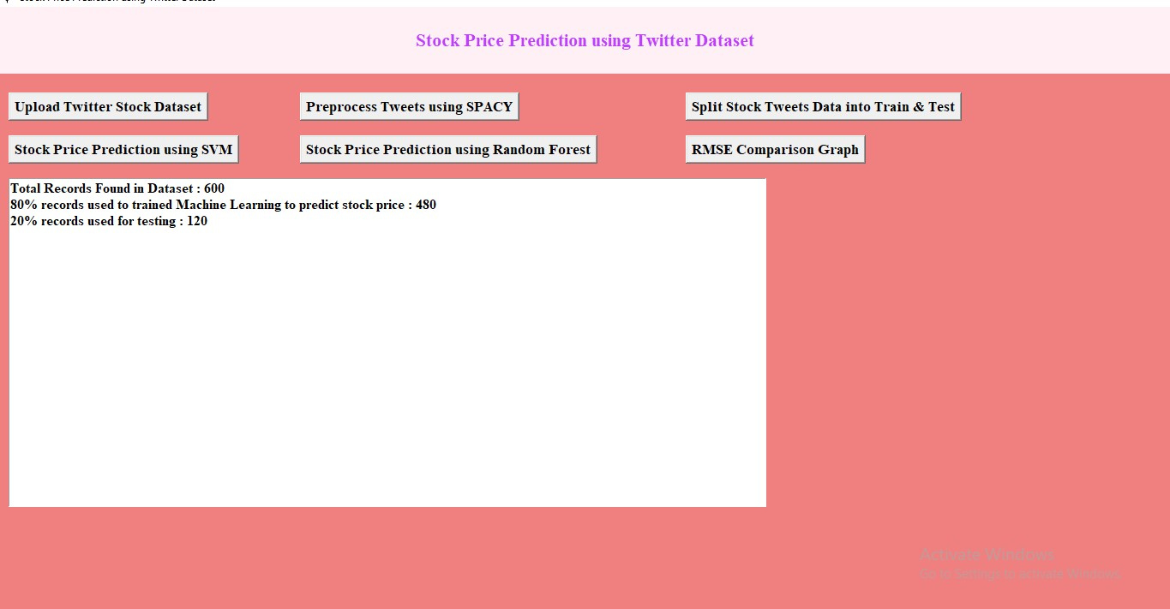
In above screen we can see dataset contain 600 tweets and application using 80% (480) tweets for training and 20% (120) tweets for testing and now train and test data is ready and now click on ‘Stock Price Prediction using SVM’ button to train SVM and get below output
DEPT.OF.COMPUTER APPLICATIONS

Slide 26
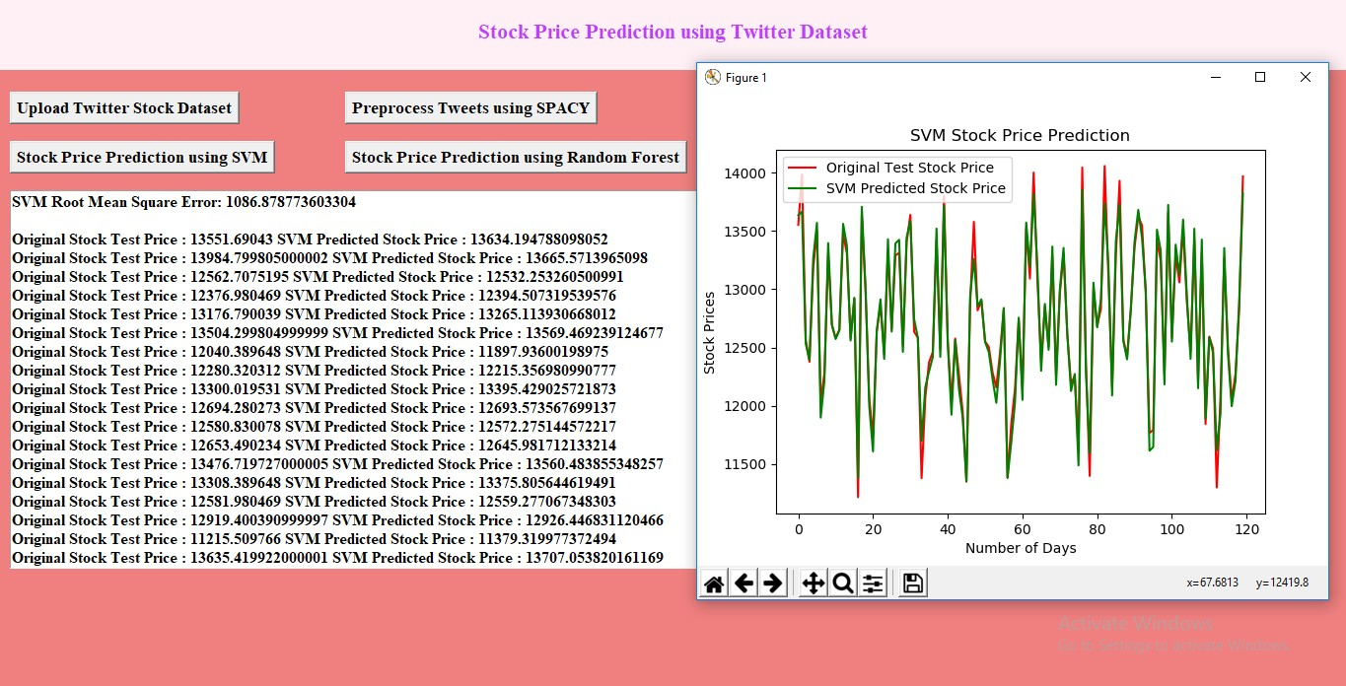
In above screen in text area we can see original test stock prices and SVM stock prices and we got SVM RMSE as 1086(difference between predicted and original prices) .We can say SVM performance is good but not best so close above graph and then click on ‘Stock Price Prediction using Random Forest’ button to train with Random Forest and get below output
DEPT.OF.COMPUTER APPLICATIONS

Slide 27
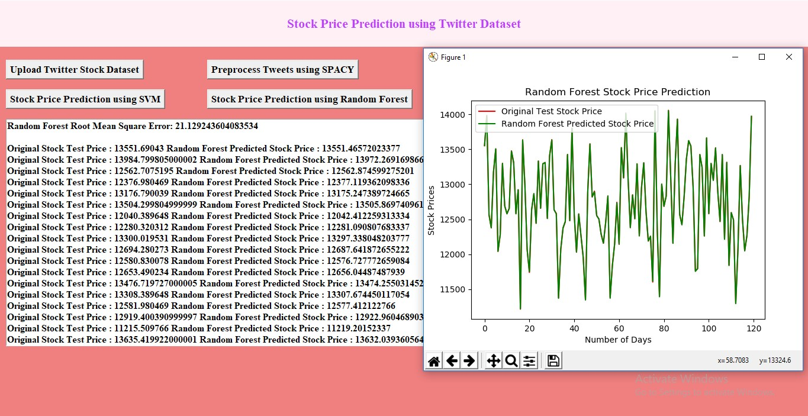
In above screen with Random Forest we got RSME as just 21 and in graph we can see both lines are fully overlapping so TEST prices and Random Forest predicted prices are accurate. So Random Forest is best in performance.
Now close above graph and then click on ‘RMSE Comparison Graph’ button to get below graph
DEPT.OF.COMPUTER APPLICATIONS

Slide 28
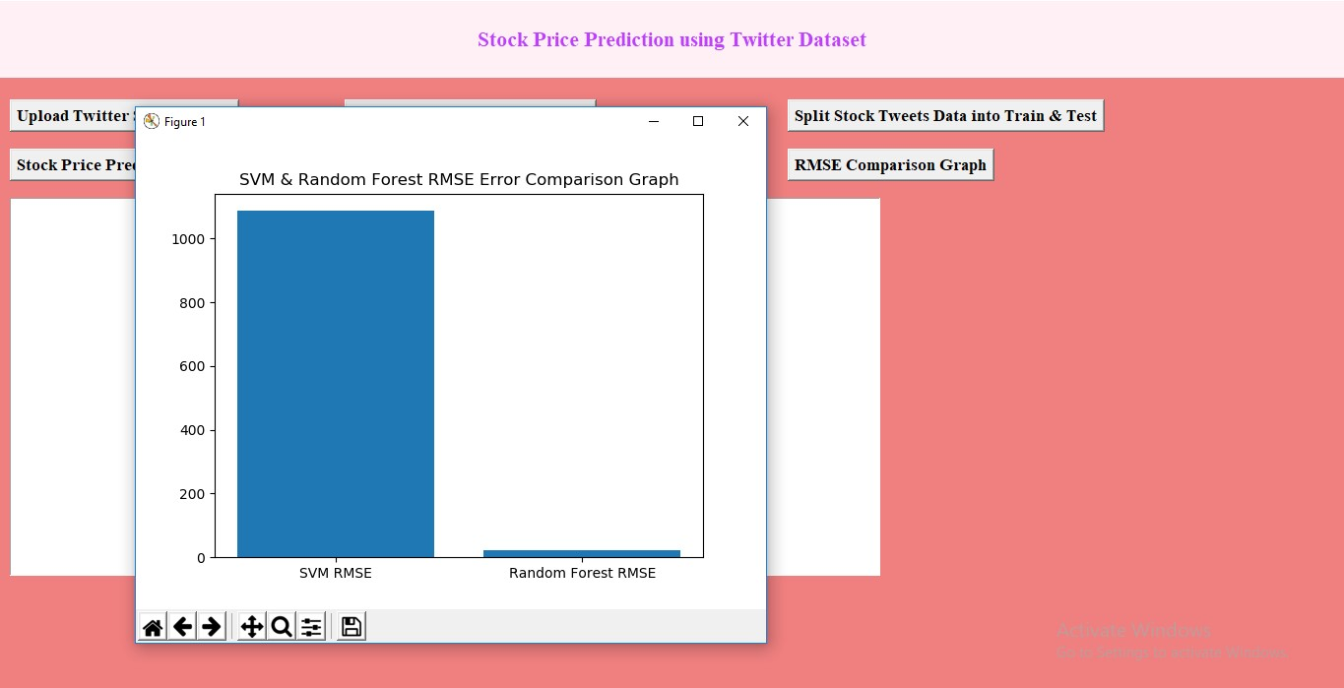
In above graph x-axis represents algorithm names and y-axis represents error rate and in both algorithms Random Forest got less error so its performance is best. The lower the error the better is the algorithm.
DEPT.OF.COMPUTER APPLICATIONS

Slide 29
CONCLUSION
We have investigated the causative relation between public mood as measured from a large scale collection of tweets from twitter.com and the DJIA values.
Finally a naive implementation of portfolio management using our strategy indicates a decent profit over a range of 40 days.
All these remain as areas of future research.
DEPT.OF.COMPUTER APPLICATIONS 20

Slide 30
REFERENCES
I wish to avail the opportunity to express thanks to Mr. N. CHANDRAKANTH , HOD, Dept. of Computer Applications, for his constant support, inspiration and motivation throughout the project.
I also thank my project guide Mrs. A. SUSANNA RANI, Assistant Professor, PVKK Institute of Technology for their constant guidance and valuable advice.
DEPT.OF.COMPUTER APPLICATIONS 21

Slide 31
THANK
YOU
DEPT.OF.COMPUTER APPLICATIONS 22

